Slide 1


Slide 2

Version 0.1
DPU – SMART WATER BOX

Slide 3

Agenda
Overview
Objective
Introduction
Process
Protection and Licensing
Technology and Tools
Timeline
Risk management
Conclusion

Slide 4

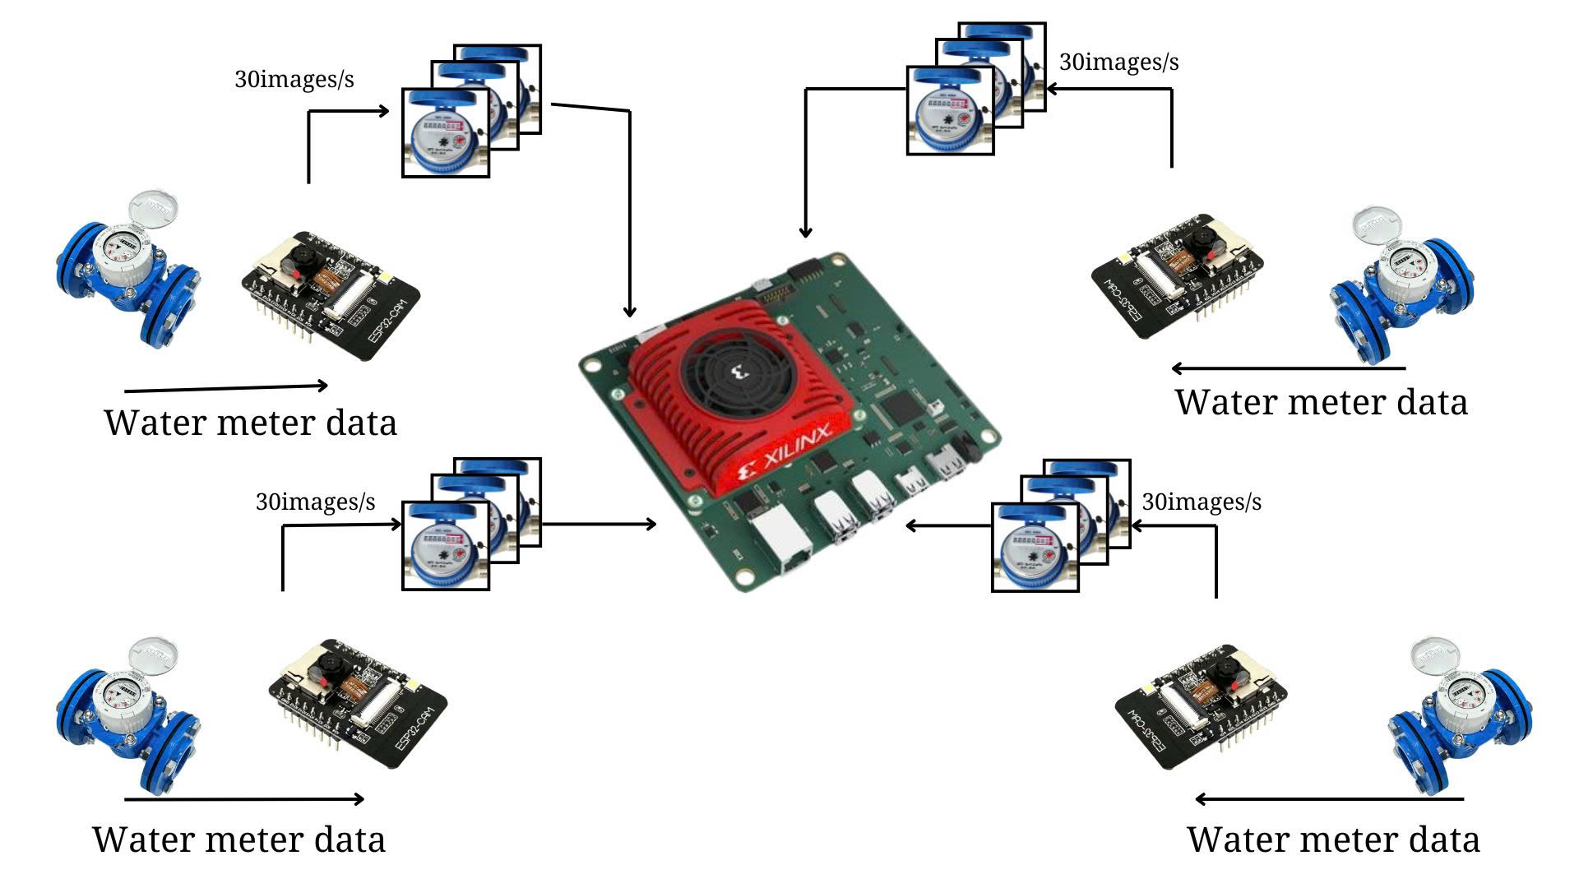
1. Overview
The DPU - Smart Water Box is an FPGA based processing module that process raw image from water meters and sensor signal from environmental factors.
Focus solely on reading water meter digits with high reliability.
Results are forwarded to the platform for storage, visualization, and analysis eliminating manual sampling and laboratory delays.

Slide 5
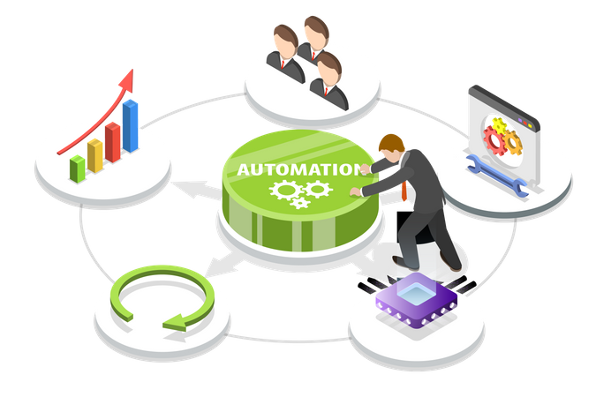
2. Objective
Eliminate manual “collect sample → lab test” steps by performing in‑field processing.
Accelerate data availability and consistency for the ecosystem, minimizing human‑entry errors.
Provide a hardware foundation ready for future integration of additional water‑quality sensors.

Slide 6
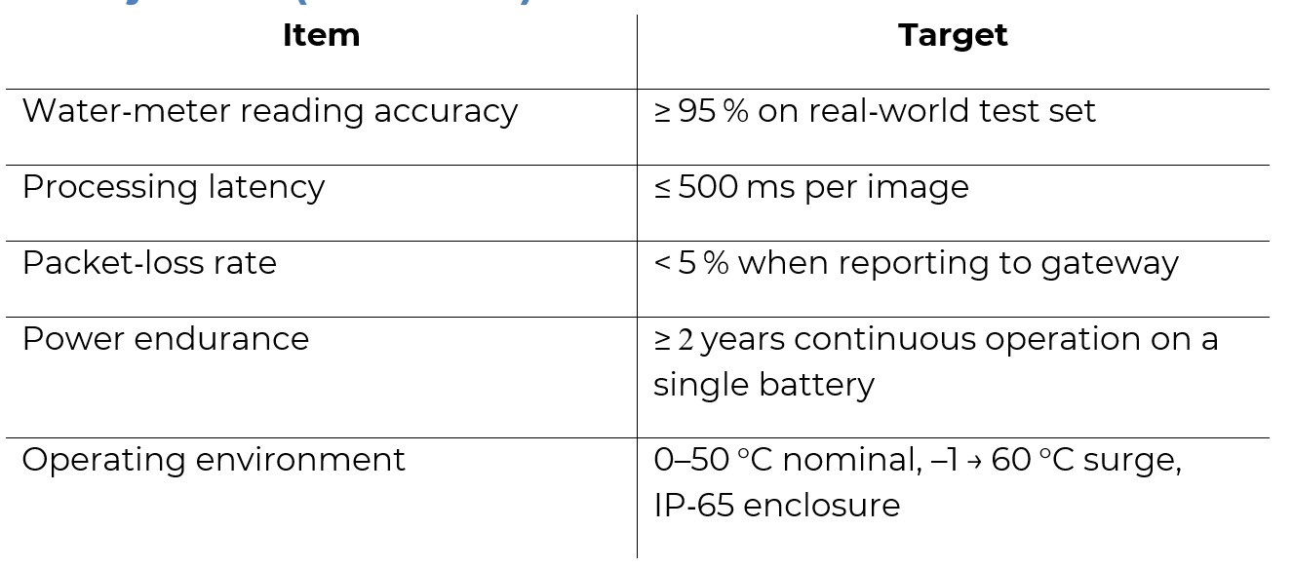
2. Objective

Slide 7
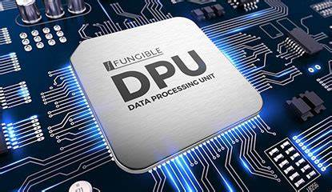
3. Introduction
The DPU - Smart Water Box using DPU on FPGA to perform all image and sensor-signal processing at the edge, delivering data readings with high accuracy.
Forwarding results to the gateway for reduction of manual sampling and test cost and transcription errors to maintain low-power, standalone design for future integration of pH, turbidity, salinity, and other water-quality sensors.

Slide 8
4. Project Process
Phase 1: Research & Development​
Phase 2: Implementation & Simulation​
Phase 3: Verification & Validation

Slide 9
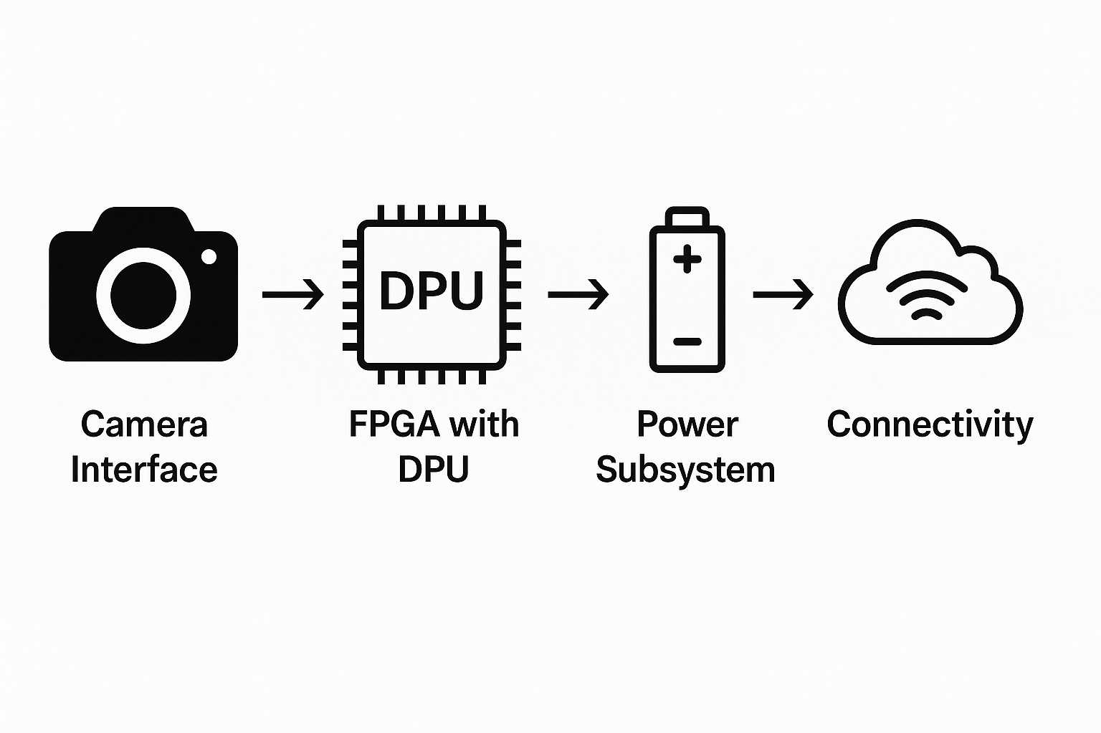
4. Project Process
Phase 1: Research & Development​
Define functional requirements and investigate the multiple scenarios.
Propose a lightweight model machine learning with high accuracy and inference timing.
Initiate end-to-end block diagram such as camera interface, DPU on FPGA, power subsystem, and connectivity.

Slide 10
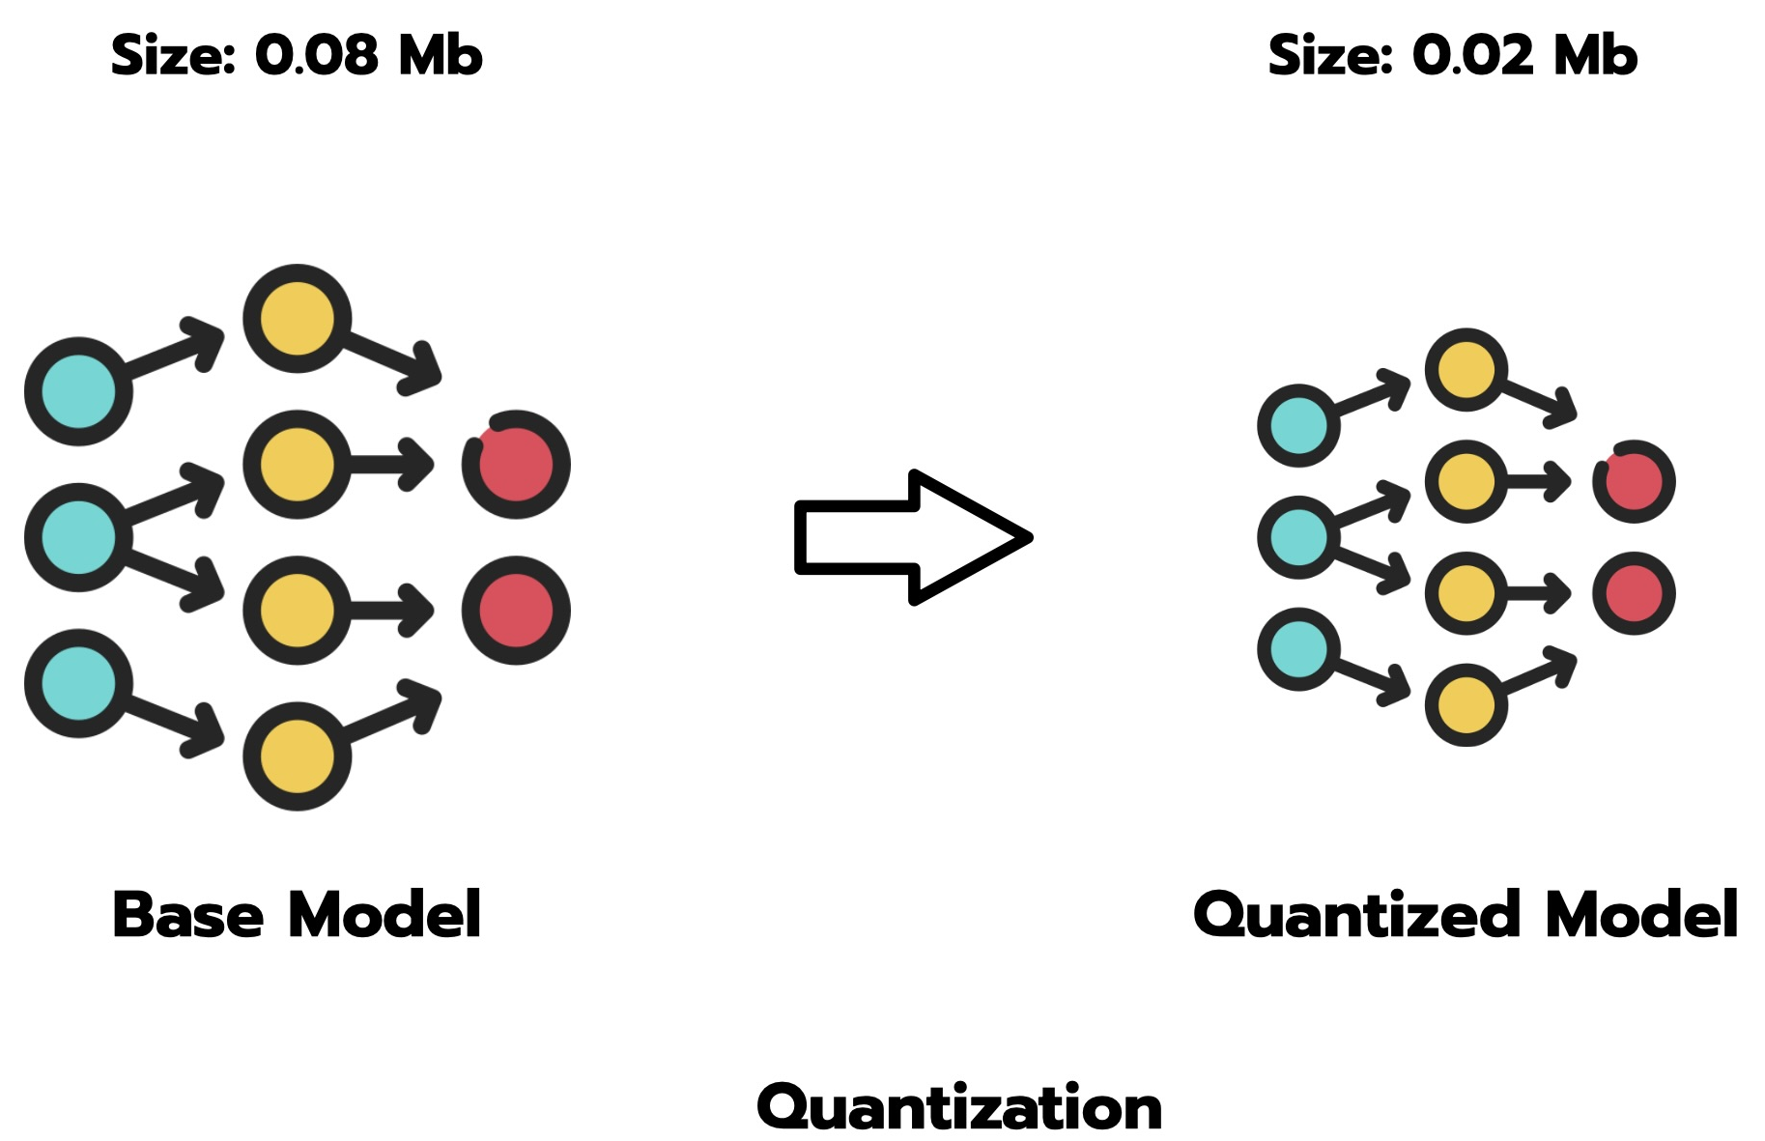
4. Project Process
Phase 2: Implementation & Simulation​
Quantization of 8-bit weight/activation and retrain the model to maintain high accuracy.
Export the network to QONNX, run FINN to generate HLS IP cores and iterate on HLS settings to optimize resource.
Deploy on the FPGA, integrate the camera module and power subsystem inside an IP package.
Synthesize and implement the FPGA design and package the overlay perform for timing analysis.

Slide 11
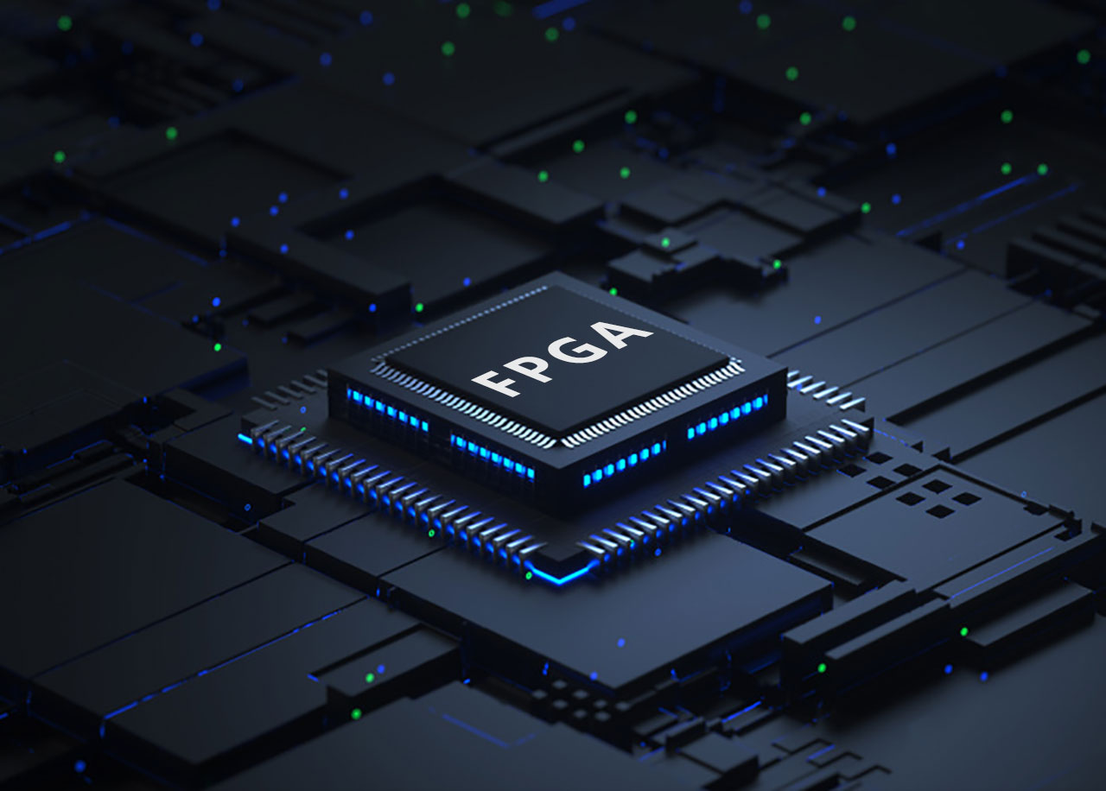
4. Project Process
Phase 3: Verification & Validation
Run multiple test to achieve good latency and high accuracy across multiple real-world samples.
Subject the prototype to temperature, vibration, and network‐loss scenarios and validate packet-loss recovery and battery endurance.

Slide 12

5. Protection and Licensing
Once a design is finalized and validated, file for patents to protect the intellectual property.
Create documentation and support tools to facilitate integration and licensing.
Develop licensing strategies to market and distribute the IP to interested parties.

Slide 13

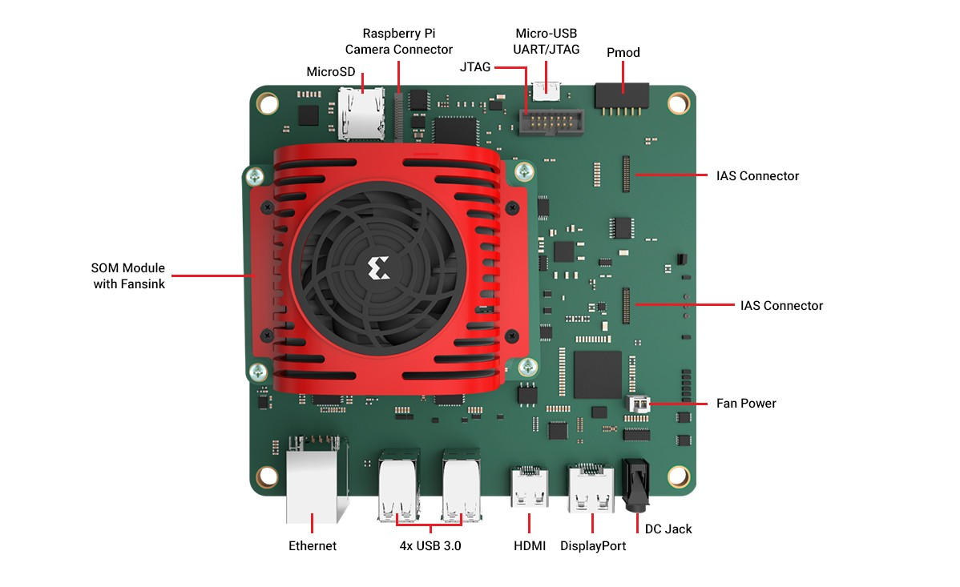
6. Technology and Tools
Design Software:
Xilinx Vivado HLS
VSCode
Jupyter Notebook
Technologies:
FPGA & DPU
High Level Synthesis
Machine learning algorithms for detection and OCR in fully RTL implementation

Slide 14
Timeline
1-3/2025: Market research, requirements gathering, and initial implementation.
4-8/2025: Develop, testing and evaluation version 0.1
9-12/2025: Update to version 0.2
12/2025: IP licensing and documentation
1/2026: Ready to launch Version 1.0
1-10/2026: Launch version 1.0 while develop version 1.1 and 1.2
10/2026: IP licensing and documentation
11-12/2026: Launch version 2.0 and develop new feature in background

Slide 15
Risk management
Technical Risk: Potential challenges in achieving the desired performance or overcoming design constraints. Mitigation: Frequent design reviews and prototyping to minimize unexpected outcomes.
Market Risk: Difficulty in finding licensees or customers. Mitigation: Engage with industry partners early in the design process and explore different licensing models.
Financial Risk: Budget overruns due to unforeseen design or prototyping challenges. Mitigation: Regular project monitoring and contingency planning.

Slide 16
Conclusion
The DPU - Smart Water Box based FPGA to perform on-device image and sensor processing delivering water-meter readings with hig accuracy and completely eliminating manual sampling, lab tests, and transcription errors.
Forwarding results to the gateway for real-time dashboards, threshold alerts to slash labor costs, accelerates decision-making, and enables proactive leak detection and resource optimization.
Modulate FPGA architecture with I²C/UART expansion headers and firmware-driven overlays supports seamless addition of pH, turbidity, salinity, and other water-quality sensors ensuring scalable, future-proof deployments.

Slide 17



